Slide 1
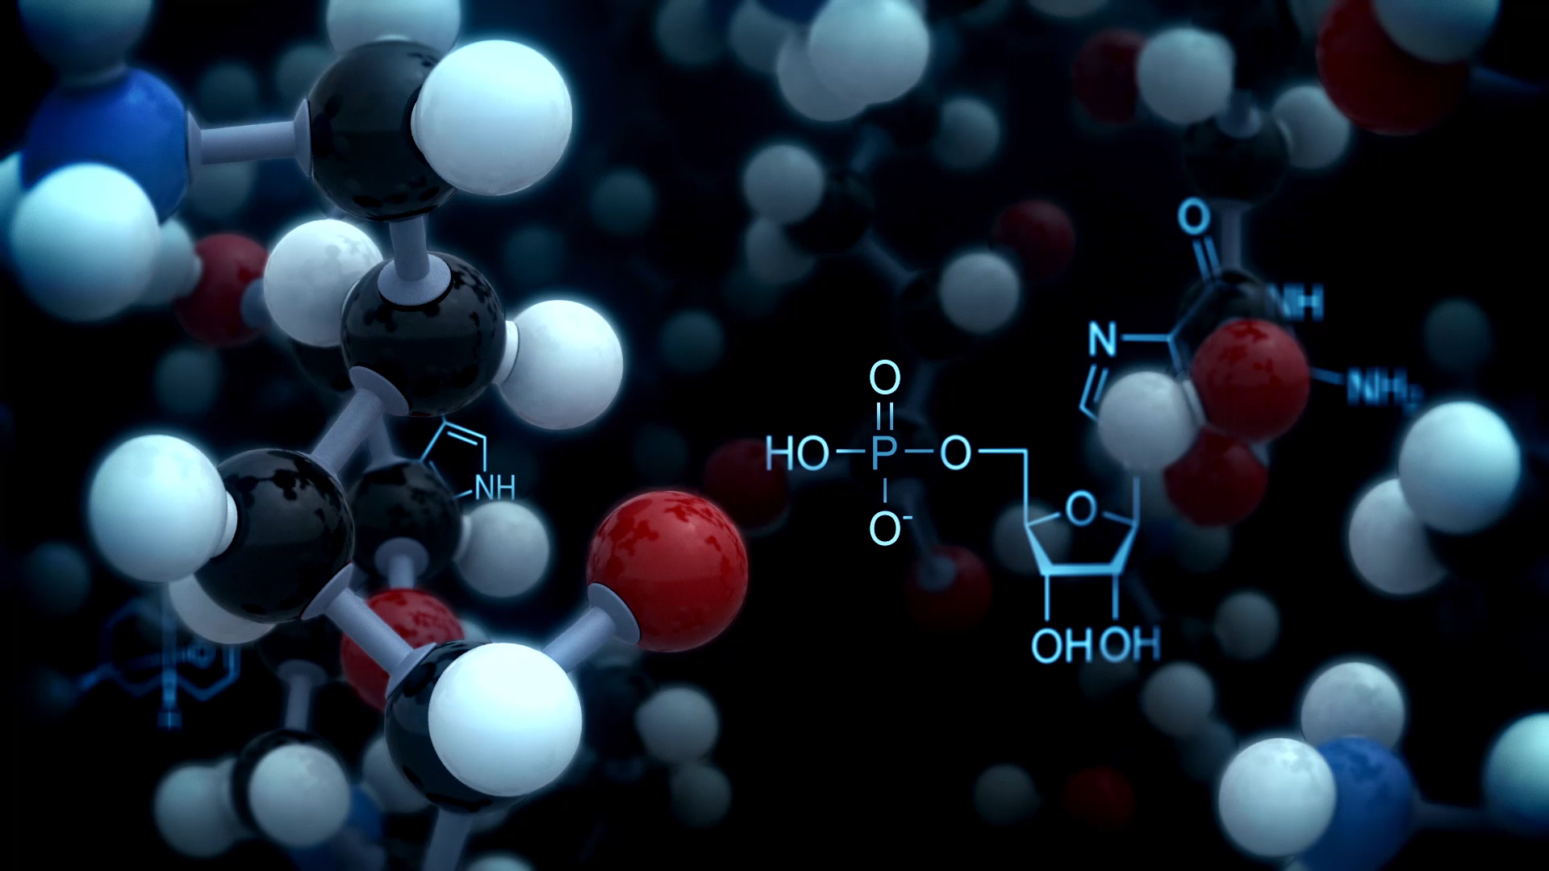
HYDROGEN
ABHA KOLHE
CLASS- VIII-A
ROLL NO. 2
SUBJECT- CHEMISTRY

Slide 2
DISCOVERY
Hydrogen was initially called Inflammable Gas.
Robert Boyle in 1672 established the elementary character of hydrogen.
Henry Cavendish in 1776 first prepared hydrogen in the pure state and also described its properties and recognized it as an element.
Lavoisier in 1783 established its name hydrogen meaning water producer .

Slide 3
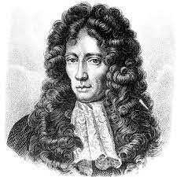
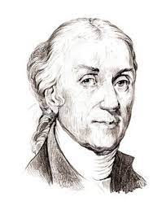
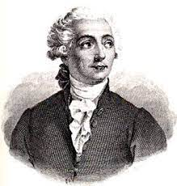
Robert Boyle
Henry Cavendish
Lavoisier

Slide 4
OCCURENCE
In the free state
Earth’s crust | 0.98%
Earth’s atmosphere | 0.01%
Volcanic gases | 0.025%
Atmosphere – around the sun and the stars | 01.1%
Hydrogen does not exist in free state in atmosphere.

Slide 5
OCCURENCE
IN COMBINED STATE-
Hydrogen is distributed in combination with other elements in the combined state.
In plant and animal tissues.
In water .
As a constituent of different substances.

Slide 6
GENERAL METHODS
Metals like potassium, sodium and calcium are attacked by cold water, releasing hydrogen and forming corresponding metallic hydroxide. The reaction in case of lighter elements like, potassium and sodium is explosive in nature and sometimes the hydrogen gas released catches fire.
METAL | COLD WATER | METAL HYDROXIDE | HYDROGEN
2K + | 2H2O → | 2KOH + | H2
2Na + | 2H2O → | 2NaOH + | H2
Ca + | 2H2O → | Ca(OH)2 + | H2

Slide 7
METAL | BOILING WATER | METALLIC OXIDE | HYDROGEN
Mg + | H2O → | MgO + | H2
Zn + | H2O → | ZnO + | H2
3Fe + | 4H2O → | Fe3O4 + | 4H2
Metals like magnesium, zinc and iron are attacked by steam provided the metals are heated. They form their respective metallic oxides and release hydrogen gas. However, the reaction is fairly slow.

Slide 8
PREPARATION OF HYDROGEN BY LABORATORY METHOD
REACTANTS: Granulated Zinc{Zn} in flat bottom flask.
:Dilute Hydrochloric Acid{HCl} added through thistle funnel.
PROCEDURE: Granulated Zinc is placed in the flat bottom flask and HCl is added slowly from the thistle funnel.
PRECAUTIONS:
No leakage of gas should take place and no flame must be near the apparatus.
The end of thistle funnel should dip below the level of dil. Acid the flask or the H2 gas may escape out though the funnel.
Hydrogen is collected after all the air in the apparatus is allowed to escape.

Slide 9
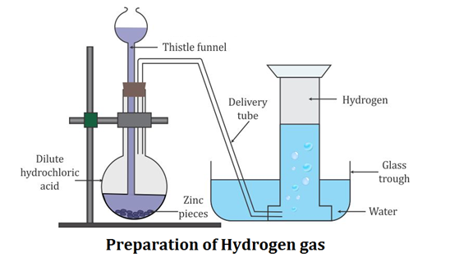
Zn+2HCl2→ZnCl2+H2

Slide 10
TEST FOR HYDROGEN
A mixture of hydrogen and air burns with a characteristic pop sound.
Hydrogen burns in air with very pale blue flame and the only product formed is water. The water thus formed can be tested by white anhydrous copper sulphate which turns blue.

Slide 11
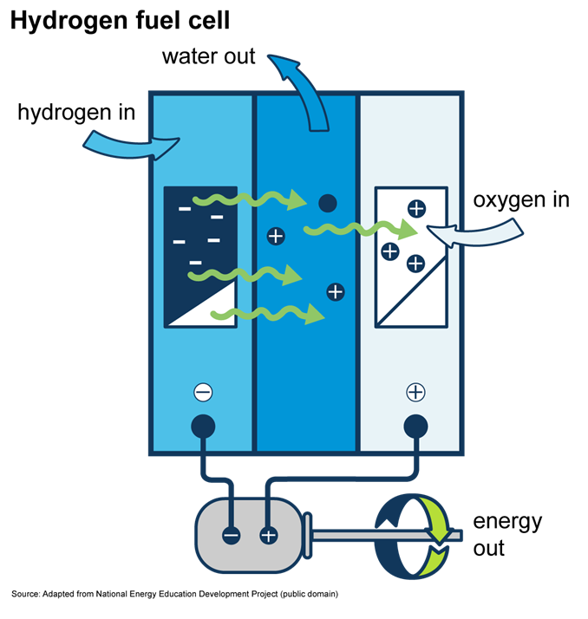
USES OF HYDROGEN
GENERAL USES-
As a fuel- in the form of
Coal gas
Water gas
Liquid hydrogen

Slide 12
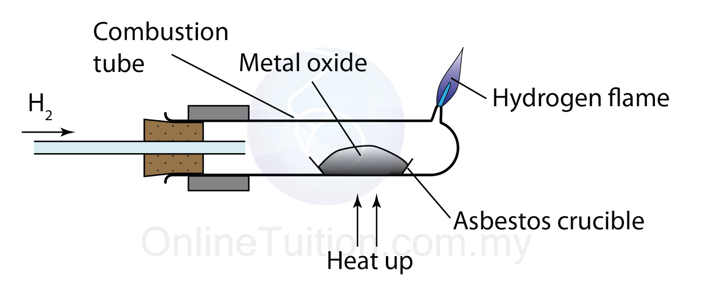
EXTRACTION OF METALS
As hydrogen is a good reducing agent, it is used for the extraction of metals like tungsten, copper, lead and tin from their oxides.

Slide 13
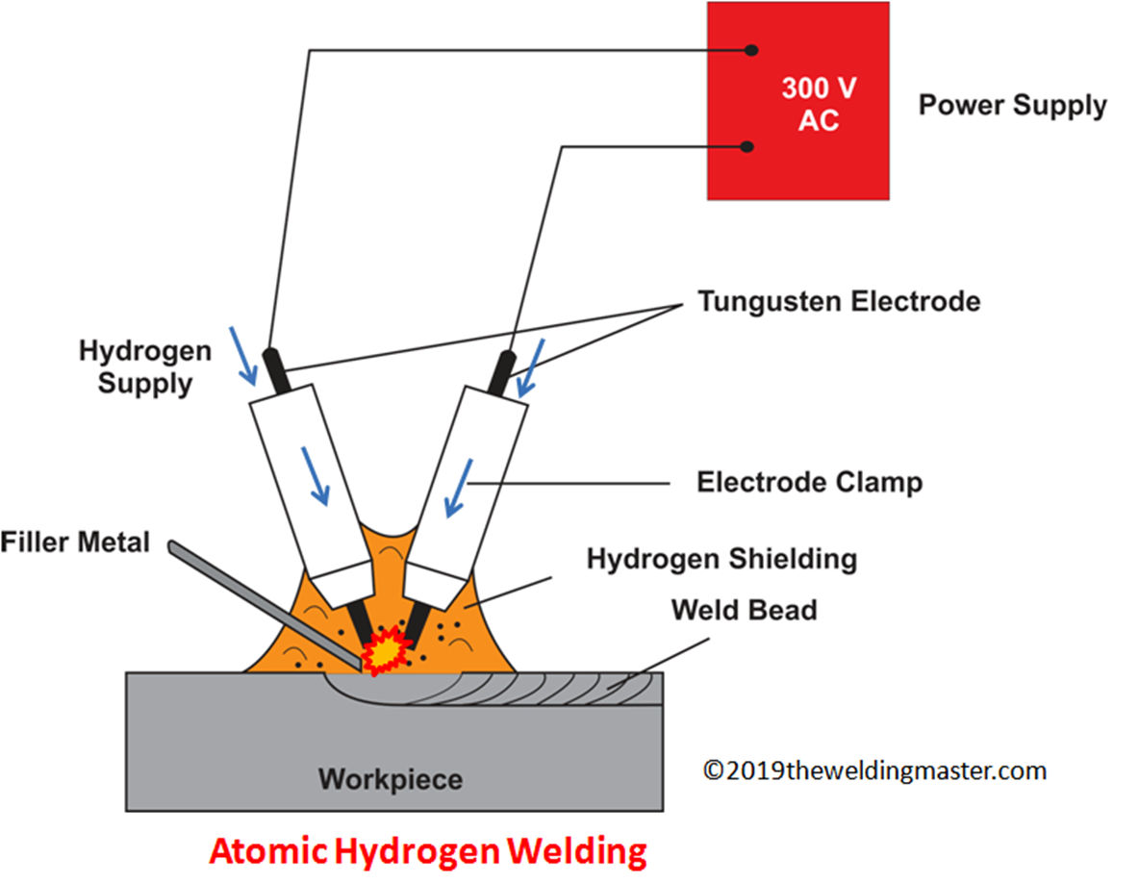
FOR WELDING AND CUTTING PURPOSES
A flame of hydrogen and oxygen as a temperature of around 2800C. This flame is called oxy-hydrogen flame and is used for cutting and welding purposes.

Slide 14
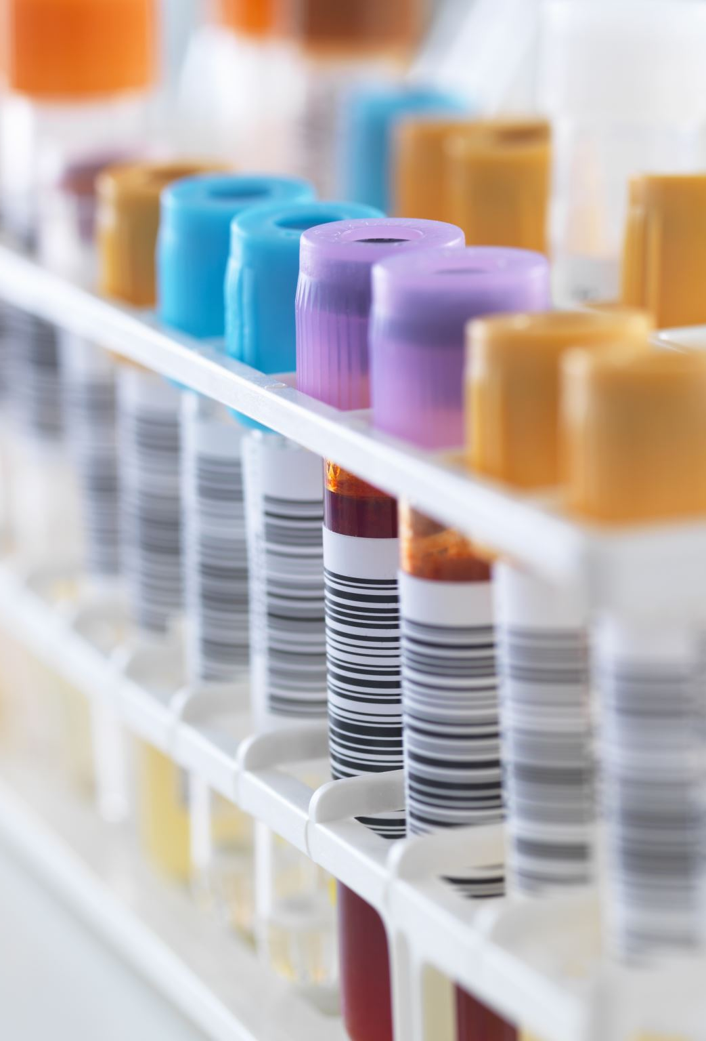
OXIDATION AND REDUCTION
Oxidation was first used for a reaction in which oxygen combined with a substance
The donor of oxygen was the oxidizing agent.
Reduction was first used for a reaction in which oxygen was removed from a substance.
The acceptor of oxygen was the reducing agent.

Slide 15
THANK YOU

